Slide 1
GEOSS Case Study
SE4950 System of Systems Engineering [and Integration] (SoSE&I)
System of Systems Engineering of GEOSS
Module 3, Case Study
April 17, 2013
Team 1
Lewis W. Berklich
Steve Mazza
Ralph Pinnock
Daniel Torres

Slide 2
Topics
GEOSS System of Systems
GEOSS Description and Background
Application of SoSE to GEOSS
SoSE Activities For GEOSS
System Characteristics and its Paradoxes

Slide 3
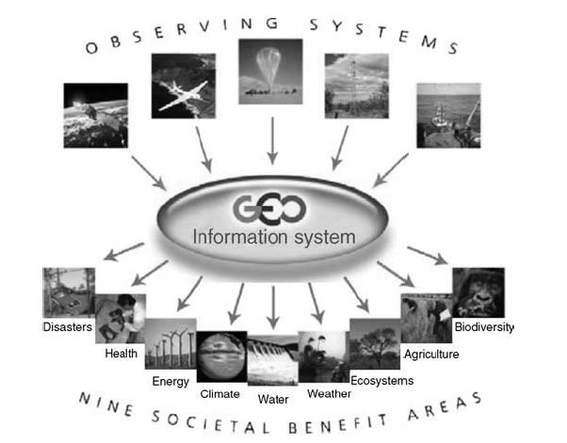
System of Systems
Source: Jamshidi, M. (2009). System of Systems Engineering: Innovations for the 21st Century

Slide 4
Description and Background

Slide 5
Application of SoSE to GEOSS

Slide 6
SoSE Activities for GEOSS

Slide 7
System Characteristics / Paradoxes

Slide 8
Add

Slide 9
Open Discussion

